Slide 1

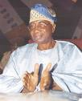

Things Fall Apart, 1959
Chinua Achebe

Slide 2
“Let me first make one general point that is fundamental and essential to the appreciation of African issues by Americans.
Africans are people in the same way that Americans, Europeans, Asians, and others are people.
Africans are not some strange beings with unpronounceable names and impenetrable minds.
Although the action of Things Fall Apart takes place in a setting with which most Americans are unfamiliar, the characters are normal people and their events are real human events.”
Achebe

Slide 3
“He had already chosen the title of the book, after much thought: The Pacification of the Primitive Tribes of the Lower Niger.”
“In 1959, he published Things Fall Apart as a response to novels, such as Joseph Conrad’s Heart of Darkness, that treat Africa as a primordial and cultureless foil for Europe. Tired of reading white men’s accounts of how primitive, socially backward, and, most important, language-less native Africans were, Achebe sought to convey a fuller understanding of one African culture and, in so doing, give voice to an underrepresented and exploited colonial subject.”

Slide 4
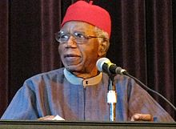
Achebe 1930-2013

Slide 5
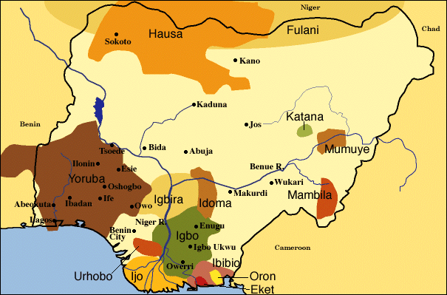

Slide 6
Things Fall Apart
Things Fall Apart (written in 1958) deals with the clash of cultures and the violent transitions in life and values brought about by British colonialism in Nigeria in late 1800s.
Things Fall Apart includes Western linguistic forms and literary traditions with Igbo words and phrases, proverbs, fables, tales, and other elements of African oral and communal storytelling traditions.

Slide 7

Yam
sweet potato-- In some African cultures it was used as currency

Slide 8
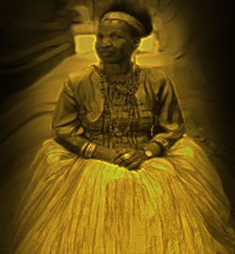
oracle
A person believed to be in communication with a deity (god or gods)

Slide 9
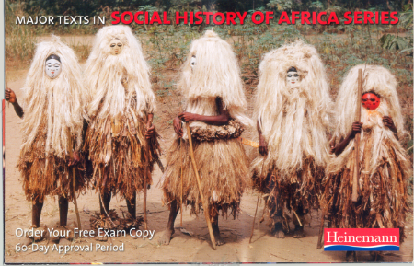
Egwugwu
A masquerader who impersonates one of the ancestral spirits of the village

Slide 10
Title from WB Yeat’s The Second Coming (ix)
The most famous known all to the world
Achebe’s form and language is masterful although English is his second language
He has a Christian household and background with education in English Literature
Ibo (Igbo) culture and life melded into his writing
Unsatisfactory models (x, son paragraf)
Writing for moral reasons (xi 4. paragraf)

Slide 11
Nation building, modern national consciousness
Things Fall Apart is a historical fiction
A universal novel (xii, 2. paragraf)
Ibo culture is destroyed, now it is the time of Christian cycle and culture
A heroic tale of Okonkwo (or tragic)
Masculine vs. feminine – Unoka vs Okonkwo
Tragic flaw of Okonkwo (xiv)
Balance in Umuofia

Slide 12
A family history and Ibo social life
“a world we don’t know” (xiv, son paragraf)
A true historical record of colonization of the Iboland.
Ozo – ndichie – egwugwu
British colonial brutality (xvi ilk paragraf)
Nigeria became a colony in 1886
“iron horse” ?
Christian missionaries – and Okonkwo’s aim
Nwoye lost his religion and Igbo values

Slide 13
Violence and resistance - of Okonkwo
Mr Brown – Akunna
Rev. James Smith
The leaders are ambushed and prisoned
“Enemy inside”
Achebe’s other books:
  No Longer at Ease
  Arrow of God

